Slide 1
Child Safeguarding Information Sharing

Slide 2
Introduction
Notes:
Child safeguarding is a primary duty for individuals and organisations involved in the welfare of children. One of the key components of this responsibility is the sharing of information related to children's well-being. This lesson will delve into the significance of sharing child safeguarding information, the legal framework that governs it, the guidelines for responsible information sharing, the challenges encountered in this process, strategies to overcome these challenges, an introduction to the Child Protection Information Sharing (CP-IS) system, a myth-busting guide to clarify misconceptions, an explanation of the concept of consent in information sharing, and a conclusion emphasising the importance of this practice.

Slide 3
Aims & Objectives
Understanding the importance of sharing information in child safeguarding
Familiarise yourself with the legal framework and guidelines
Identify common challenges in information sharing and strategies to address them
Explore the Child Protection Information Sharing (CP-IS)
Clarify misconceptions through a myth-busting guide
Define the concept of consent in information sharing
Notes:
Information sharing is critical for preventing child abuse and neglect. It allows professionals and agencies to work together to ensure the safety and welfare of children.
Knowing the legal obligations and best practices is crucial to ensure compliance and protect children effectively.
Recognising the obstacles to information sharing and learning how to overcome them helps create a more effective safeguarding system.
Understanding how technology can facilitate information sharing is essential in modern child protection efforts.
Addressing common myths and misconceptions promotes responsible information sharing and cooperation among professionals.
Consent is a fundamental aspect of respecting individuals' privacy and rights when sharing their information for safeguarding purposes.
Understanding how technology can facilitate information sharing is essential in modern child protection efforts.

Slide 4
Importance of information sharing
Effective information sharing is vital because it:
Enhances the overall well-being and safety of children
Ensures timely identification and intervention
Enables different agencies and professionals to work together
Prevents duplication of efforts and resources
Notes:
1) Information sharing helps identify children at risk of harm or neglect promptly. This early identification can prevent further harm and provide necessary support.
2) Collaboration is essential in child safeguarding. Sharing information allows professionals from various disciplines to coordinate efforts and ensure comprehensive care.
3) Effective information sharing reduces redundancy in assessments and investigations, optimising resource allocation.
Safeguards children's rights to protection and support: Children have a right to be protected from harm. Sharing information is a fundamental way to uphold these rights.
4) Ultimately, the goal of information sharing is to create a safer and more supportive environment for children to grow and thrive.

Slide 5
The 7 golden rules to information sharing
Information sharing: advice for practitioners (publishing.service.gov.uk)
Notes:
Remember that the General Data Protection Regulation (GDPR), Data Protection Act 2018 and human rights law are not barriers to justified information sharing, but provide a framework to ensure that personal information about living individuals is shared appropriately.
Be open and honest with the individual (and/or their family where appropriate) from the outset about why, what, how and with whom information will, or could be shared, and seek their agreement, unless it is unsafe or inappropriate to do so.
Seek advice from other practitioners, or your information governance lead, if you are in any doubt about sharing the information concerned, without disclosing the identity of the individual where possible
Where possible, share information with consent, and where possible, respect the wishes of those who do not consent to having their information shared. Under the GDPR and Data Protection Act 2018 you may share information without consent if, in your judgement, there is a lawful basis to do so, such as where safety may be at risk. You will need to base your judgement on the facts of the case. When you are sharing or requesting personal information from someone, be clear of the basis upon which you are doing so. Where you do not have consent, be mindful that an individual might not expect information to be shared.
Consider safety and well-being: base your information sharing decisions on considerations of the safety and well-being of the individual and others who may be affected by their actions
Necessary, proportionate, relevant, adequate, accurate, timely and secure: ensure that the information you share is necessary for the purpose for which you are sharing it, is shared only with those individuals who need to have it, is accurate and up to-date, is shared in a timely fashion, and is shared securely.
Keep a record of your decision and the reasons for it – whether it is to share information or not. If you decide to share, then record what you have shared, with whom and for what purpose

Slide 6
Legal framework
1) The Children Act 1989 and 2004
2) Working Together to Safeguard Children 2023
3) Data Protection Laws
4) Information Sharing Protocols
5) The Care Act 2014
6) Mandatory Reporting Laws
7 )Local Safeguarding Children Partnerships (LSCPs)
8) Penalties and Accountability
Notes:
In the United Kingdom, the legal framework related to child safeguarding information is governed by a combination of laws, regulations, and guidance that set out the responsibilities, obligations, and processes for handling, sharing, and protecting information about children at risk of harm or abuse. The key elements of the legal framework for child safeguarding information in the UK include:
The Children Act 1989 and its subsequent amendments, including the Children Act 2004, form the foundation of child protection legislation in the UK. These Acts emphasise the paramountcy principle, which states that the best interests of the child should be the primary consideration in all actions and decisions affecting them. The Acts also introduce the concept of the "duty to cooperate" among agencies and professionals involved in child safeguarding, emphasising the importance of sharing information and working together to protect children.
Working Together to Safeguard Children" is statutory guidance issued by the UK government. It provides a comprehensive framework for agencies and professionals involved in child safeguarding and outlines best practices for information sharing. The guidance emphasises the importance of consent, necessity, and proportionality when sharing information. It also sets out procedures for conducting assessments and developing child protection plans.
Data protection laws, such as the General Data Protection Regulation (GDPR) and the Data Protection Act 2018, govern the processing and sharing of personal data, including information related to child safeguarding. These laws require that personal data be processed lawfully, fairly, and transparently. Individuals (or their legal guardians) must be informed about how their data will be used and have the right to access and rectify their data.
Local authorities and agencies often develop their own information sharing protocols, which provide practical guidance on sharing information about children at risk. These protocols are designed to ensure consistency and clarity in information sharing practices within specific areas.
The Care Act 2014 introduced a legal framework for adult safeguarding in England. While primarily focused on adults, it includes provisions related to information sharing between adult and child safeguarding services when the safety and well-being of children are at risk within a family.
In the UK, there are no national mandatory reporting laws that require specific professionals to report child abuse or neglect. However, individual professions and organisations may have their own reporting requirements and codes of practice.
LSCPs were established in England under the Children Act 2004 and are responsible for coordinating and overseeing child safeguarding efforts at the local level. They play a role in developing and implementing local policies and procedures, including those related to information sharing.
Failure to comply with child safeguarding information laws and regulations can result in penalties, including disciplinary action for professionals, legal action against agencies, and fines for data protection breaches.
It's important for professionals and organisations involved in child safeguarding in the UK to be well-versed in these legal requirements and guidance documents. Compliance with the legal framework ensures that information about children at risk is handled responsibly and that children receive the protection and support they need while respecting their rights and privacy.

Slide 7
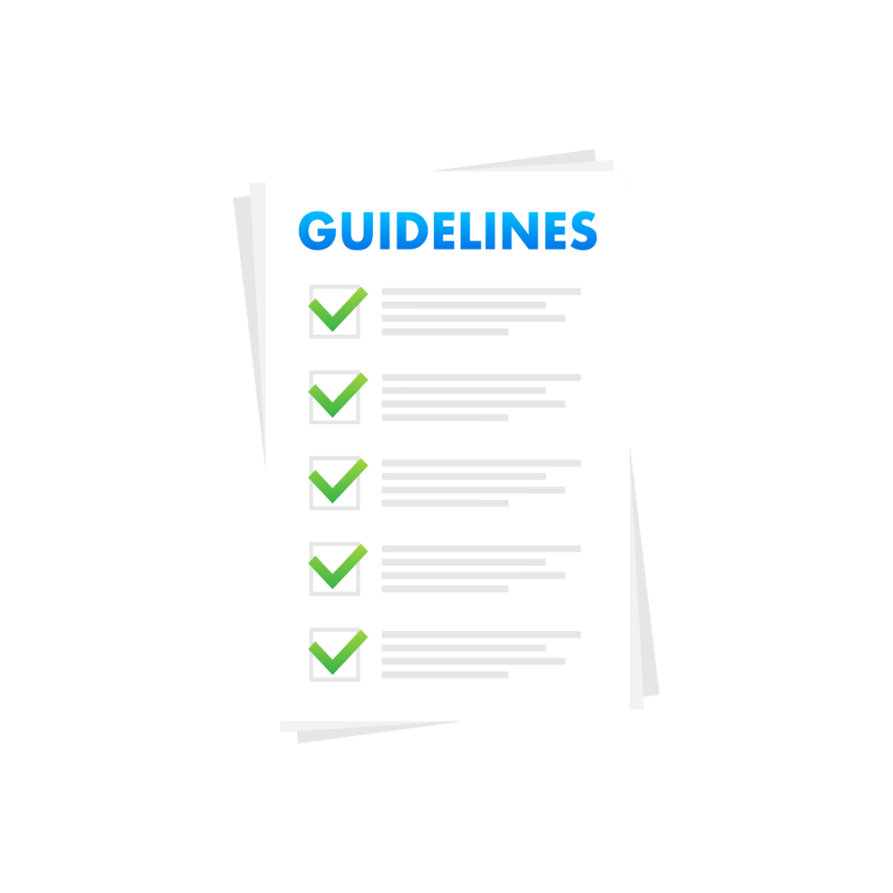
Guidelines for Child safeguarding information sharing
Working Together to Safeguard Children 2023
Information sharing for Safeguarding Practitioners
Notes:
These documents provide a comprehensive set of guidelines for sharing information responsibly in child safeguarding. It emphasises the importance of consent, necessity, and proportionality when sharing information. These principles ensure that information is shared appropriately and ethically.

Slide 8
Challenges and prevention strategies in child safeguarding information sharing
1) Lack of knowledge - Training and Awareness Programmes
2) Unclear policies and procedures - Clear and Consistent Policies and Procedures
3) Hesitancy in sharing information - Encouraging a Culture of Information Sharing
4) Data protection and privacy concerns around information sharing –
Enhanced Data Protection Measures
5) Lack of effective communication and collaboration - Interagency Collaboration and Communication
6) Outdated or inefficient information systems – Updated technology and Information Systems
7) Obtaining consent can be challenging - Consent Protocols
8) Ensuring ongoing compliance and effectiveness of information sharing practice –
Regular Audits and Reviews
9) Navigating complex legal and ethical considerations - Legal and Ethical Guidance
10) Awareness of Information Sharing - Public Awareness and Education
Notes:
Overcoming challenges in child safeguarding information sharing is crucial to ensure the safety and well-being of children at risk. Various obstacles can impede the effective exchange of information among professionals and agencies. Here are strategies and approaches to overcome these challenges:
1) Challenge: Many professionals may lack sufficient knowledge or training in child safeguarding information sharing.
Solution: Implement regular training programs and workshops to educate professionals about the legal framework, guidelines, and best practices for information sharing. These programs should emphasise the importance of safeguarding and the ethical responsibilities of sharing information.
2) Challenge: Inconsistent or unclear policies and procedures can lead to confusion among professionals.
Solution: Develop and maintain clear and consistent policies and procedures for information sharing. Ensure that these guidelines are easily accessible and regularly updated. Promote adherence to these policies across all relevant agencies and organisations.
3) Challenge: Professionals may be hesitant to share information due to fears of repercussions or a lack of a collaborative culture.
Solution: Foster a culture that values and prioritises information sharing in child safeguarding efforts. This can be achieved through leadership support, recognition of good practices, and emphasising that the primary goal is the protection and well-being of children.
4) Challenge: Balancing the need for information sharing with data protection and privacy concerns.
Solution: Invest in robust data protection measures, including encryption, secure access controls, and audits of data handling practices. These measures can help ensure that shared information remains confidential and is only accessible to authorised individuals.
5) Challenge: Lack of effective communication and collaboration among different agencies and professionals.
Solution: Promote regular communication and collaboration between relevant agencies involved in child safeguarding. Establish formal channels for sharing information and conducting joint assessments. Multi-agency meetings and case conferences can facilitate effective collaboration.
6) Challenge: Outdated or inefficient information systems can hinder timely information sharing.
Solution: Invest in modern information systems that enable secure and efficient information sharing. Ensure that these systems comply with data protection regulations and support interoperability between different agencies.
7) Challenge: Obtaining informed and voluntary consent can be challenging, especially when dealing with vulnerable individuals.
Solution: Develop clear protocols for obtaining consent in child safeguarding situations. Ensure that individuals, or their legal guardians, fully understand the implications of sharing their information and are aware of their right to revoke consent at any time.
8) Challenge: Ensuring ongoing compliance and effectiveness of information sharing practices.
Solution: Conduct regular audits and reviews of information sharing processes to identify and address any issues or gaps. Seek feedback from professionals involved in child safeguarding to continuously improve the system.
9) Challenge: Navigating complex legal and ethical considerations in information sharing.
Solution: Seek legal counsel and ethical guidance to ensure that information sharing practices comply with relevant laws and ethical standards. Stay informed about changes in legislation and adapt practices accordingly.
10) Challenge: Ensuring that parents, caregivers, and children are aware of the importance of information sharing. - Solution: Launch public awareness campaigns and educational initiatives to inform the community about the role of information sharing in child protection. Engage with families to build trust and encourage their active involvement in the safeguarding process.
By implementing these strategies and approaches, professionals and agencies can work together effectively to overcome challenges in child safeguarding information sharing and ultimately create a safer environment for vulnerable children.

Slide 9
Child protection Information sharing (CP-IS)
Information Shared
Real time information sharing
Benefits
Security and Data Protection
In Summary
Notes:
CP-IS is a secure electronic system used in England to share child protection information between healthcare and social care professionals. By doing so, it helps identify and support children for whom there are already existing child protection concerns or who are looked after.
1) Child Protection Information Sharing (CP-IS) is an electronic system designed to improve child safeguarding efforts by facilitating the secure exchange of critical information between healthcare and social care professionals. It ensures timely identification of children at risk of harm or neglect, promotes efficient communication and collaboration, and complies with legal and data protection requirements. CP-IS is an invaluable tool in the broader effort to protect the well-being of vulnerable children but it does not replace the need for individual professionals to share information with one another.
CP-IS allows the secure exchange of information related to child safeguarding and will alert the Local Authority if a child subject to a child protection plan (including unborn child) or is a Looked After Child has attended an unscheduled healthcare setting such as Accident & Emergency. The alert is sent to the LA but no further information is provided, so there remains a responsibility on practitioners to share more detailed information if deemed appropriate. The system also enables the sharing of Local Authority information that a child is subject to a Child Protection Plan or is a Looked After Child with NHS organisations providing unscheduled healthcare, to enable enhanced assessment of vulnerability.
2) CP-IS operates in real-time, which means that when a child accesses healthcare services, their information can be quickly and securely shared with relevant health and social care professionals. This immediate exchange of information helps in the early identification of potential risks and allows for timely intervention.
3) •Improved Safety: CP-IS enhances child safety by ensuring that healthcare professionals are aware of any ongoing child protection concerns, enabling them to consider this piece of information in their clinical opinion.
•Efficient Communication: It streamlines communication between healthcare and social care professionals, reducing the risk of information gaps or delays.
•Better use of resource: Less time spent searching for and providing information freeing up resources to apply elsewhere.
•Enhanced Collaboration: It fosters collaboration among agencies and professionals involved in child safeguarding.
4) CP-IS prioritises data security and confidentiality. It employs robust encryption and access controls to safeguard shared information, ensuring that it is accessible only to authorised individuals.
Building on the success of the initial CP-IS programme, this programme is now being extended in a second phase to include scheduled healthcare settings in 2024.

Slide 10
Myth busting guide
Notes:
Address common misconceptions related to information sharing, such as the belief that sharing information is unnecessary or that it violates privacy. This is designed to address common misconceptions and doubts regarding information sharing. It aims to provide clarity and encourage responsible information sharing practices. Examples of myths that may be addressed include concerns about sharing unnecessary information, violating privacy rights, or causing harm through sharing.
Data protection legislation is a barrier to sharing information
No - the Data Protection Act 2018 and GDPR do not prohibit the collection and sharing of personal information, but rather provide a framework to ensure that personal information is shared appropriately. In particular, the Data Protection Act 2018 balances the rights of the information subject (the individual whom the information is about) and the possible need to share information about them.
Consent is always needed to share personal information
No - you do not necessarily need consent to share personal information. Wherever possible, you should seek consent and be open and honest with the individual from the outset as to why, what, how and with whom, their information will be shared. You should seek consent where an individual may not expect their information to be passed on. When you gain consent to share information, it must be explicit, and freely given. There may be some circumstances where it is not appropriate to seek consent, because the individual cannot give consent, or it is not reasonable to obtain consent, or because to gain consent would put a child's or young person's safety at risk.
Personal information collected by one organisation/agency cannot be disclosed to another
No - this is not the case, unless the information is to be used for a purpose incompatible with the purpose for which it was originally collected. In the case of children in need, or children at risk of significant harm, it is difficult to foresee circumstances where information law would be a barrier to sharing personal information with other practitioners.
The common law duty of confidence and the Human Rights Act 1998 prevent the sharing of personal information
No - this is not the case. In addition to the Data Protection Act 2018 and GDPR, practitioners need to balance the common law duty of confidence and the Human Rights Act 1998 against the effect on individuals or others of not sharing the information.
IT Systems are often a barrier to effective information sharing
No - IT systems, such as the Child Protection Information Sharing project (CP-IS), can be useful for information sharing. IT systems are most valuable when practitioners use the shared data to make more informed decisions about how to support and safeguard a child.
Practitioners looking to share information should consider which processing condition in the Data Protection Act 2018 is most appropriate for use in the particular circumstances of the case.

Slide 11
What is consent
Consent is not always needed to share information but is always preferred. Consent is not required where the information needs to be shared to safeguard a child, but key points to understand about consent in Child Safeguarding Information Sharing include:
Informed Consent
Voluntary Consent
Revocable Consent
Childs Capacity to Consent
Parental/Guardian Consent
Best Interests of the Child
Consent Records
Confidentiality and Data Security
Consent within Legal Framework
Notes:
Consent should be informed, meaning that individuals, or their guardians, should have a clear understanding of what information is being shared, why it is being shared, and the potential implications of sharing that information. They should be provided with sufficient details to make an informed decision.
Consent should be voluntary and not obtained through coercion, pressure, or manipulation. Individuals should be free to choose whether they want to give consent or not, without facing adverse consequences for refusing.
Consent should be revocable at any time. This means that individuals, or their guardians, have the right to change their minds and withdraw their consent to share their information. They should be informed about this right.
When dealing with children, it's essential to consider their age and maturity. Younger children may not have the capacity to give informed consent, and in such cases, consent should be obtained from their legal guardians. Older children who are considered mature enough may be involved in the decision-making process.
In cases where the child is not considered mature enough to provide informed consent, the consent of their parents or legal guardians is typically sought before sharing any information related to the child's well-being.
The paramount consideration in obtaining consent for information sharing in child safeguarding is the best interests of the child. Consent should be sought when sharing information is necessary to protect the child from harm or provide them with necessary support and services.
It's advisable to maintain clear records of consent, including who provided it, when it was obtained, and for what specific information or purpose. These records can help ensure accountability and compliance with legal and ethical standards.
Ensuring that the shared information is treated with the utmost confidentiality and subject to robust data security measures is essential. This helps maintain the trust of individuals who have provided consent.
Consent practices in child safeguarding must align with the legal framework governing child protection in your jurisdiction. Be aware of any specific legal requirements or guidelines related to consent and information sharing.
In summary, consent in child safeguarding information sharing is a critical aspect of respecting the rights and autonomy of individuals, especially children, while also fulfilling the obligation to protect them from harm. Obtaining informed, voluntary, and revocable consent ensures that information is shared responsibly and ethically in the context of child safeguarding.

Slide 12
Why record keeping is important
Notes:
Good quality record keeping is an important part of the accountability of professionals to those who use their services
Clear and accurate records ensure that there is a documented account of an agencies or professional’s involvement with the child and/or his or her family or caregiver
Records are an essential source of evidence for investigations and inquiries and may also be required to be disclosed in court proceedings. Well-kept records provide an essential underpinning to good professional practice
To serve these purposes records should use clear, straightforward language, be concise and be accurate not only in fact, but also in differentiating between opinion, judgement and hypothesis
Consent is always preferred but in cases where information has been shared without consent to safeguard a child, this needs to be well documented.
Records should be clear, accessible and comprehensive, with judgements made and decisions and interventions carefully recorded
Where decisions have been taken jointly across agencies or endorsed by a manager, this should be made clear

Slide 13
Group challenge
Notes:
After the discussions on information sharing and record keeping do a group challenge . Need to buy 2 x copies of a book called Zoom by Istvan Banyai and 1 of the books take apart and laminate – the activity varies in time but usually set aside up to 30 minutes for this.
Instructions
Each participant gets one picture (unless more than 30 in which case pair up)
Explain that participants may only look at their own pictures and must keep their pictures hidden from others!
Encourage participants to study their picture, as it contains important information to help solve a problem!
The challenge is for the group to sequence the pictures in the correct order without looking at one another’s pictures!
When the group believes they have all the pictures in order, the pictures can be turned over for everyone to see.
Once the challenge is finished, allow everyone to see the pictures and encourage participants to sort out any mistakes in the order and then let everyone see the pictures in sequence so they understand the full story.
Debriefing the activity
Why was it hard to get the story together? (everyone had a piece, but no-one had the big picture)
What type of communication was used in attempting to solve the problem?
What communication methods might have worked better? (Imagine if, at the beginning, the group had taken time to let each person describe their picture to the rest of the group? What would have happened then? Would the solution have been found faster? – Experience shows that most groups chat with people near them and then wander around before somebody takes charge!!
If you were to tackle a similar activity again, what do you think this group could do differently?
What’s the reason for undertaking this activity now? (Ties in with information sharing and recording and highlights the challenges if we’re not clear!!)

Slide 14
Conclusion
Notes:
Child safeguarding information sharing is a critical aspect of protecting children from harm. It is essential for professionals and organisations to understand their legal obligations, guidelines, and best practices in this area. By addressing challenges and implementing effective strategies, we can create a safer environment for children, ensuring their well-being and protection. In conclusion, child safeguarding information sharing is a critical component of ensuring the safety and well-being of children. It is not only a legal obligation but also a moral imperative. By understanding the legal framework, following guidelines, addressing challenges, and fostering a culture of responsible information sharing, we can create a safer environment for children and uphold their rights to protection and support. Ultimately, effective information sharing plays a pivotal role in safeguarding children from harm and promoting their overall welfare.

