Slide 1
Compassionate Approach to Tackling Obesity (Weight Neutral)
Alison Millbourn
Public Health Manager

Slide 2
Exploring a weight neutral approach
We want to try a new approach to issues of weight and health that is driven primarily by compassion, takes blames away from individuals and fully acknowledges the mental and financial burden poverty and inequality places on people.
Weight neutral is an intervention or service where weight change or weight control is not the sole intended outcome, and that often the evidence suggests that they do not necessarily lose weight…..but hear me out….

Slide 3
Why be weight neutral?
Weight focused interventions - evidence suggests:
Gains from initial weight loss not sustained over long term
Weight regained in large proportion of people over time
Weight loss interventions may lead to harmful weight cycling and dysfunctional relationships with food and body
Weight neutral interventions – evidence suggests:
Health gains maintained over longer term
Better psychological outcomes
No evidence of harm

Slide 4
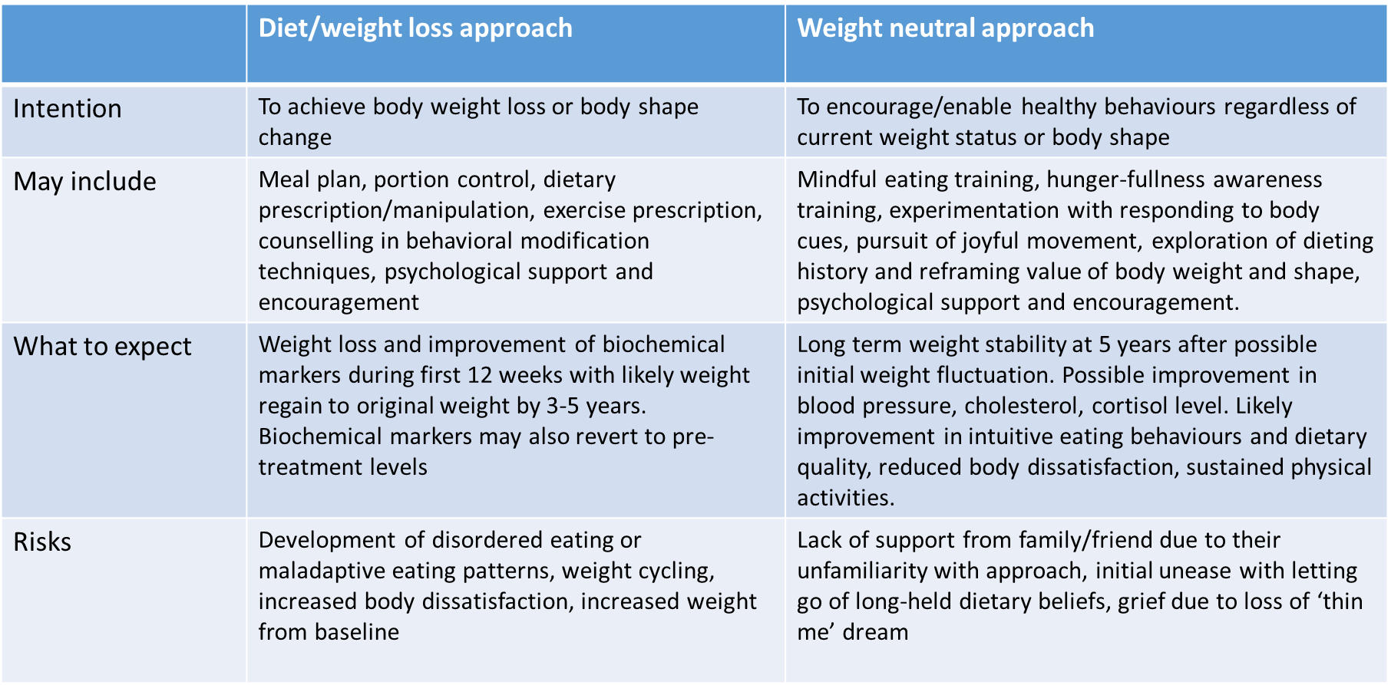

Slide 5
Approx 90% of people in all BMI categories have room for improvement in their dietary quality, so why are we only having conversations with those with a BMI 25+
The picture is similar in terms of meeting recommended levels of PA, but we generally assume that those with a higher BMI are inactive.
Neither does BMI necessarily classify who is cardiometabolically healthy and who isn’t (BP, cholesterol, insulin resistance, etc) - approx. 50% are misclassified!
Obesity is mostly determined by the wider social, economic, commercial and environmental determinants of health, even if it appears to be grounded in individual behaviour.
When focussing on weight loss, energy deficit is improved and it is this that in turn improves biochemical results, not the weight loss per se.

Slide 6
What a weight neutral intervention would look like
Size accepting - encourage/enable healthy behaviours regardless of current weight status or body shape
Emphasis on body acceptance and self worth
Focus on health gains and longevity boosters that are independent to weight, size , or shape e.g.
Regular activity/movement
Improving diet quality/better nutrition

Slide 7
Social support
Sleep
Smoking cessation
Reduced alcohol consumption
Keep a process focus rather than end-goals, day-to-day quality of life
Maintains a holistic focus given that health is multidimensional
Increase access, opportunity, freedom.
Rooted in principles of social justice, aiming to lift up the systematically disadvantaged and challenge the environmental and social structures that create inequalities

Slide 8
For those who chose to pursue weight loss
Ultimately the wishes of the individual must be respected
Can still incorporate principles of weight neutral approaches (self compassion; joyful movement; improving nutrition etc)
Be honest about pros and cons of pursuing weight loss, offer an alternative
There would be some caveats, e.g. obesity during pregnancy; pre-surgery; MSK issues, etc.

Slide 9
An example of a weight-neutral approach – Non-Diet Approach
Fiona Willer – Australian Dietitian developed this as a clinical approach to her Health at Every Size (HAES) values.
HAES values =
Weight inclusivity
Health enhancement
Respectful care
Eating for wellbeing
Life enhancing

Slide 10
Weight Inclusivity:
Accept and respect the inherent diversity of body shapes and sizes and reject the idealizing or pathologizing of specific weights
Health Enhancement:
Support health policies that improve and equalize access to info and services, and personal practices that improve human well-being, including attention to individual physical, economic, social, spiritual, emotional and other needs

Slide 11
Respectful Care:
Acknowledge our biases, and work to end weight discrimination, weight stigma and weight bias. Provide info and services from an understanding that socio-economic status, race, gender, sexual orientation, age and other identities impact weight stigma, and support environments that address these inequalities
Eating for Wellbeing:
Promote flexible, individualised eating based on hunger, feeling full, nutritional needs, and pleasure, e.g. ‘intuitive eating’ rather than any externally regulated eating plan focused on weight control.
Life Enhancing Movement:
Support physical activities that allow people of all sizes, abilities and interests to engage in enjoyable movement, to the degree that they choose

Slide 12
Finally….
Assumptions are made that heavier people are unhealthy, this is not necessarily so
Weight loss through dieting is not sustainable over time
We would be acting on behalf of our population if we centralise health for people at all points along the weight continuum and work to eradicate stigma in all settings, including healthcare
Weight loss leads to body pre-occupation, distracts from other health goals and wider determinants, reduced self-esteem, eating disorders, other health decrement, weight stigmatisation and discrimination
It would negate the need for people to have embarrassing conversations about weight with adults and children. It would be a more positive conversation about health.
NCMP

Slide 13
Want to know more?
https://www.openlearning.com/healthnotdiets/courses/introduction-to-the-non-diet-approach/homepage/?cl=1

