Slide 1
LESSONS LEARNED: USING REVIEWS TO PREVENT SERIOUS HARM TO CHILDREN
Copyright Kirklees Safeguarding Children Partnership April 2020

Slide 2
GOV.UK GUIDANCE CLOSING CERTAIN BUSINESSES AND VENUES
On 23 March 2020 the UK government stepped up measures to prevent the spread of coronavirus and save lives.
Businesses and workplaces should encourage their employees to work at home, wherever possible. People must not meet in groups of more than 2 in public places unless they live together or their job means that they have to. Events have been stopped including Kirklees Safeguarding Children classroom courses.
Kirklees is now offering online training that will help you to continue to do your day to day role and offer you opportunities for further reading.
Copyright Kirklees Safeguarding Children Partnership April 2020

Slide 3
Aim
To understand the different types of safeguarding reviews and how practitioners can use the lessons that have been identified to prevent child deaths and serious harm
Copyright Kirklees Safeguarding Children Partnership April 2020

Slide 4
Outcomes
By the end of the course you will be able to:
Outline the different types of reviews that can be used to learn lessons in safeguarding children
Identify issues raised in both local & national serious case reviews
List the different factors affecting infant mortality in Kirklees
Transfer the lessons learned from reviews into your everyday practice
Acknowledge the emotional impact that serious case reviews have on those involved, colleagues, managers and the general public
Copyright Kirklees Safeguarding Children Partnership April 2020

Slide 5
Notifying Kirklees Safeguarding Children Partnership (KSCP) of a child death
Agencies notify the KSCP of a child death by following the link below.
The link to the site allows users to fill and submit a form to notify the team of an expected or unexpected death.
https://www.kirkleessafeguardingchildren.co.uk/safeguarding-2/safeguarding-processes-and-systems/child-death-review-process/
ALL child deaths HAVE to be notified to the KSCP whether they are as a result of abuse, neglect or whatever the cause
Copyright Kirklees Safeguarding Children Partnership April 2020

Slide 6
The purpose of Safeguarding Practice Review at Local and National level
They are to identify improvements to be made to safeguard and promote the welfare of children.
Local learning is relevant
Understanding whether there are systemic issues, and whether and how policy and practice need to change
Seek to prevent or reduce the risk of recurrence of similar incidents.
Reviews are not conducted to hold individuals, organisations or agencies to account
Copyright Kirklees Safeguarding Children Partnership April 2020
Working together 2018

Slide 7
What is serious child safeguarding?
Serious child safeguarding cases are those in which:
abuse or neglect of a child is known or suspected and the child has died or been seriously harmed.
serious harm includes (but is not limited to) serious and/or long-term impairment of a child’s mental health or intellectual, emotional, social or behavioural development. It should also cover impairment of physical health. This is not an exhaustive list.
Working together 2018
Copyright Kirklees Safeguarding Children Partnership April 2020

Slide 8
Child Death Overview and Statutory responsibilities of review partners
A child is defined as a person under 18 years of age regardless of the cause of death
To learn what happened and why, and prevent future child deaths
Ensure child death reviews are carried out
Analyse information from all deaths reviewed
Offer support and guidance for family
Working together 2018
Working together 2018
Covered further in classroom training
Copyright Kirklees Safeguarding Children Partnership April 2020

Slide 9
Keeping up to date with Changes in ‘Working Together 2018’
The establishment of a Child Safeguarding Practice Review Panel to undertake reviews of national importance / highly complex.
Rapid reviews to be conducted.
Reviews to be completed within 6 months.
Child Death Overview Panel to have larger footprint.
Some changes to Child Death Overview Panel process.
Further reading recommended
Working together 2018
Copyright Kirklees Safeguarding Children Partnership April 2020

Slide 10
Role of Child Safeguarding National Panel
The National panel is responsible for understanding how the system learns the lessons from serious child safeguarding incidents
Identify and oversee the review of serious child safeguarding cases which, in its view, raise issues that are complex or of national importance
Maintain oversight of the system of national and local reviews and how effectively they are operating
Copyright Kirklees Safeguarding Children Partnership April 2020

Slide 11
Role of Local Safeguarding Children Partnership (LSCP)
Identify and review serious child safeguarding cases which, in their view, raise issues of importance in relation to their area.
Commission and oversee the review of those cases, where they consider it appropriate for a review to be undertaken.
Identify improvements to practice and protecting children from harm.
Maintain an open dialogue with the National Panel to share concerns, highlight commonly recurring areas that may need further investigation (whether leading to a local or national review), and to share learning, including from successes that could lead to improvements.
Copyright Kirklees Safeguarding Children Partnership April 2020

Slide 12
Reasons why Safeguarding Children Partnerships undertake reviews.
Abuse or neglect of a child is known or suspected
And
A child has died or been seriously harmed
(serious case review)
Serious harm includes (but is not limited to) serious and/or long-term impairment of a child’s mental health or intellectual, emotional, social or behavioural development. It should also cover impairment of physical health.
Working together 2018
Copyright Kirklees Safeguarding Children Partnership April 2020

Slide 13
What a Review is NOT
About identifying someone to take the rap!
Pinpointing professions as failing
Or a way of sweeping issues
under the carpet!
Copyright Kirklees Safeguarding Children Partnership April 2020
Notes:
From the headlines it would be easy to assume that SCRs are about finding members of staff to blame for a tragic death or serious injury to a child. That’s definitely what the media is looking for. But for the Board, we want to know what we can learn about the way professionals work together, and if there is anything we can do to help practitioners to keep children safe.
SCRs are not criminal investigations, but often run alongside criminal investigations and/or care proceedings. They do not recommend disciplinary action. Agencies are pretty open about internal problems with IT systems, caseloads, supervision

Slide 14
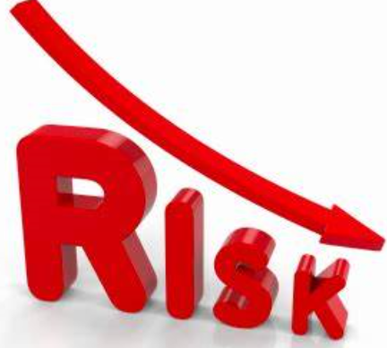
All reviews are about….
Risk reduction
not
Risk elimination
Covered further in classroom training
Copyright Kirklees Safeguarding Children Partnership April 2020

Slide 15
The Child Death Review process
The responsibility for ensuring child death reviews are carried out is held by ‘child death review partners,’ who, in relation to a local authority area in England, are defined as the local authority for that area and any clinical commissioning groups operating in the local authority area.
Child death review partners must make arrangements to review all deaths of children normally resident in the local area and, if they consider it appropriate, for any non-resident child who has died in their area.
People involved Police, Paeditrician, Designated Doctor or Nurse for safeguarding, Social services, GP or Health Visitor and any other professionals that child death review partners consider should be involved.
Copyright Kirklees Safeguarding Children Partnership April 2020

Slide 16
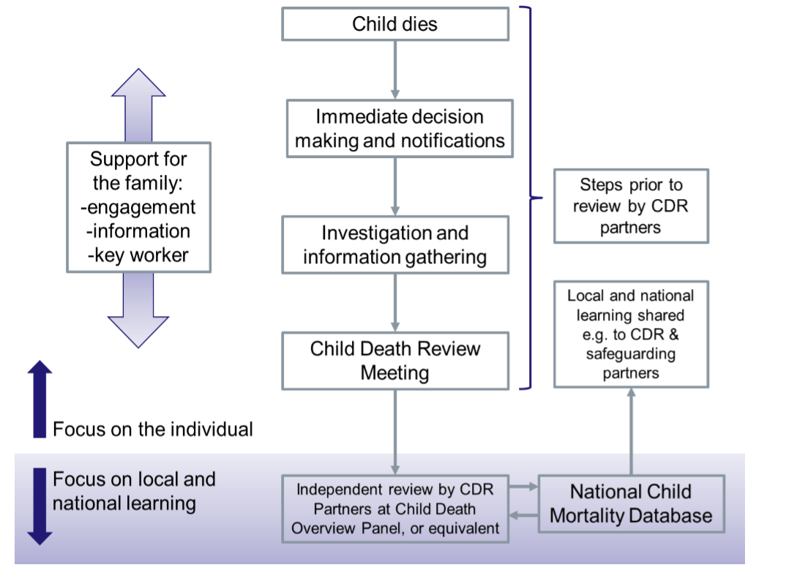
Process to follow when a child dies
Copyright Kirklees Safeguarding Children Partnership April 2020
Working together 2018

Slide 17
Why is infant mortality significant?
62% of all Child Death Overview Panel cases in 2011 – 2017 were infant deaths
The Infant Mortality rate for Kirklees is still higher than both the regional and national rates. Kirklees 5.5 -national average 4.7 per 1000 live births (source Kirklees observatory 2019)
2015 – 2020, 214 children died in Kirklees (111 / 52% in North Kirklees and 103 / 48% in South Kirklees)
Copyright Kirklees Safeguarding Children Partnership April 2020
Notes:
Infant death matters because..
… the family tragedies that the rates represent,
… the fact that it is an indicator of wider public health,
… the influence it has on life expectancy rates
… the inequalities that it exposes, because deprived communities (including income deprived and pakistani heritage people) are disproportionately affected

Slide 18
Some characteristics that impact on infant mortality
Pakistani heritage families are more affected
50% of all infant deaths were babies born prematurely (especially white babies)
48% of babies were low birth weight (under 2500 grams)
Multiple births more vulnerable
Boys more affected than girls
Higher rates of late access to maternity care
Lower take up of screening rates
Parent Smoking
Body weight and nutrition
Deprivation
Consanguinity
Diabetes
Substances misuse
Copyright Kirklees Safeguarding Children Partnership April 2020
Notes:
This information comes from an audit and analysis of almost 300 infant deaths in Kirklees up to 2012
Pakistani heritage families are over represented in infant death figures. They are both more likely to be affected by poverty, and to practice marriage within the extended family, where shared genes can have an impact on congenital chromosomal anomalies – a small number of which are life limiting.
Prematurity and low birth weight are associated with underdevelopment and a range of health issues that may affect babies’ capacity to survive and thrive.
Boys are more affected by infant death in part because there are some life limiting congenital anomalies that only affect boys, not girls.
Rates of early access and booking into maternity services are improving. Early access is important to get advice, change aspects of lifestyle, and to access screening
Screening esp important for everyone, and especially relevant if parents are related outside their marital relationship (such as cousins). People can access genetic counselling services before and after conception – access is via GPs.
Smoking affects development, birthweight, respiration etc. Smokers are more likely to have early, low-weight babies
Like elsewhere, we have growing rates of obesity –and poor nutrition (empty calories) is significant. Healthy Start / supplements are available to many women.
Simply, poor children are more likely to be affected – and poverty affects many aspects of health and health inequalities.
21% of mums in the Kirklees sample (at least) were in consanguinous relationships (‘’cousin marriage’’)

Slide 19
Factors Contributing to Childhood Deaths
Factors intrinsic to the child
Acute or Chronic illness
Disability
Prematurity / low birth weight
Age, gender, ethnicity
Behaviour difficulties
Mental health
Parental substance misuse
Family and environmental
Parental age, marital status
Health, mental health
Smoking, substance misuse
Social class, Geographic spread
Social isolation
Unsafe environments
Parenting capacity
Basic care of child
Responding to health needs
Ensuring safety
(including safe sleeping)
Emotional warmth
Guidance and boundaries
Evidence of abuse or neglect
Service provision and need
Service needs
Services provided
Gaps in provision
Information sharing
Working together 2018
Copyright Kirklees Safeguarding Children Partnership April 2020
Notes:
19
Slide 10: Factors contributing to childhood deaths
Extending the triangle of assessment to a “diamond of assessment”, We will use this framework, considering four domains:
Factors intrinsic to the child
Factors in relation to the parents/primary carers and their capacity to meet the child’s needs
Factors in the wider family and environment
Factors around service provision and need, including medical care
For each we determine different levels of influence for any identified factors:
0 – Information not available
1 – No factors identified or factors identified that are unlikely to have contributed in any way to the death
2 – Factors identified that may have contributed to vulnerability, ill-health or death
3 – Factors identified that provide a complete and sufficient explanation for the death

Slide 20
Two main medical reasons for infant deaths
Copyright Kirklees Safeguarding Children Partnership April 2020
Notes:
This slide shows is that almost the same % of babies died because of prematurity as because of a congenital anomaly. However, white babies’ deaths are much more likely to be because of prematurity, and Pakistani heritage babies are much more likely to die because of a congenital anomaly.
… note the cross – over between categories – babies with congenital anomalies are more likely to be born pre-term.

Slide 21
What preventative support can we offer
Support healthy behaviours
Be aware of vulnerable groups and individuals
Help women to access support services
Data collection and recording
Copyright Kirklees Safeguarding Children Partnership April 2020
Notes:
smoking, nutrition, alcohol, exercise etc -these matter for everyone, but are especially relevant to women who become pregnant.
Vulnerable groups - Pakistani heritage women; poor women, women in consanguinous relationships; obesity, smokers, diabetics
Informing and encouraging women to access services is important - Esp early booking for maternity care; genetic counselling & screening, & diabetes management
Still have an issue of missing data about babies and families affected. Play your part…. Good data and information helps to identify trends and new areas to focus preventative work on, and changes to make to services

Slide 22
Child deaths reviewed by category
2015-2020
Category of child death age range 0-18 years | Kirklees
Deliberately inflicted injury, abuse or neglect | 2%
2) Suicide or deliberate self-inflicted harm | 3%
3) Trauma and other external factors | 4%
4) Malignancy | 7%
5) Acute medical or surgical condition | 4%
6) Chronic medical condition | 2%
7) Chromosomal, genetic and congenital abnormalities | 40%
8) Perinatal / neonatal event | 26%
9) Infection | 7%
10) Sudden unexpected, unexplained death | 6%
Copyright Kirklees Safeguarding Children Partnership April 2020

Slide 23
Purpose of ALL reviews
To identify improvements in service delivery
To prevent future deaths
To identify patterns and whether policy and practice need to change
To identify gaps in services
Copyright Kirklees Safeguarding Children Partnership April 2020

Slide 24
Child Safeguarding practice Review Process
Serious Incident
Notification to National Panel
Rapid Review
Chronology building
Initial findings by author
Practice Learning Events
Draft report
Sign off
Publication
Responding to further learning
Copyright Kirklees Safeguarding Children Partnership April 2020

Slide 25
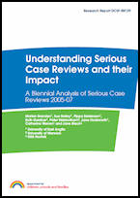
Frequency of Serious Practice reviews
In England 1 to 2 children a week are believed to die at the hands of their carers
Nationally 130 -150 SPRs per year
Kirklees: Kirklees 12 since 2016 (4 published)
The Government commissions
an analysis of these Reviews
every 2 years
Copyright Kirklees Safeguarding Children Partnership April 2020

Slide 26
How might you be involved?
Managers
Completing Information gathering
Compiling Chronology
Attending Practice Learning Event
Supporting Staff
Implementing Change
Practitioners
Involved with family
Contributing to chronology
Attending Practice Learning Event
Supporting Colleagues
Changes to practice
Copyright Kirklees Safeguarding Children Partnership April 2020

Slide 27
Common recurring themes arising from SCR/SPR in Kirklees and nationally
Ineffective assessment, planning and review processes
Poor information sharing
Lack of clarity on systems / processes
Poor contingency planning / responses to emergencies
Poor management oversight / lack of supervision
High caseloads / quality of practice
Case recording
Broader understanding of risk (especially in neglect)
Understanding pathways for complex needs (e.g. mental health, substance misuse etc.)
Understanding of historic issues
Engagement of fathers
Working with Learning disability / assessing ability to parent
Losing focus on children when there are adult issues (domestic violence, substance misuse)
Working with families who are avoidant
Lack of Professional curiosity
Copyright Kirklees Safeguarding Children Partnership April 2020

Slide 28
Summary: SPR’s – Key messages
Encourage reflective practice
Make effective use of supervision
Ensure learning from SPR’s
Develop professional judgement
Don’t be afraid to challenge
Support colleagues who are involved with SPR’s
Copyright Kirklees Safeguarding Children Partnership April 2020

Slide 29
Test yourself
1. Should Kirklees Safeguarding Children Partnership be informed in the event of a child death?
2. What is serious child safeguarding?
3. What is the purpose of Child Death Overviews?
4. What are reviews not for?
5. Name five characteristics that impact infant mortality
6. What preventative support can we offer?

Slide 30
Answers
1.Yes
2. Abuse or neglect of a child is known or suspected and the child has died or been seriously harmed
3. Ensure reviews are carried out - analyse information gathered - learn lessons to help prevent further deaths - offer support to the family
4. Blaming people, point out agencies who are failing – ignoring problems in practice.
5. See slide 18
6. Support healthy behaviours, be aware of vulnerable groups and individuals, help women to access services, Data collection and recording to help with analysis and strategic planning

Slide 31
Information for you to explore further
Working Together 2018
The NSPCC SCR Repository
The Brandon Analysis Report
Any recently published SPR’s and associated Action Plans
http://www.kirkleessafeguardingchildren.co.uk/
…and follow Safeguarding > Safeguarding Processes and Systems> Safeguarding Practice Reviews

