Slide 1
SAFEGUARDING SKILLS
Notes:
Updated August 2019
October 2018

Slide 2
GOV.UK GUIDANCE
CLOSING CERTAIN BUSINESSES AND VENUES
On 23 March 2020 the UK government stepped up measures to prevent the spread of coronavirus and save lives.
Businesses and workplaces should encourage their employees to work at home, wherever possible. people must not meet in groups of more than 2 in public places unless they live together or their job means that they have to. Events have been stopped including Kirklees safeguarding children classroom courses.
Kirklees is now offering online training that will help you to continue to do your day to day role and offer you opportunities for further reading.

Slide 3
Aim
To develop practitioners’ safeguarding skills in core competences that have an impact on outcomes for children

Slide 4
Outcomes
By the end of the course, participants will be able to:
1. Identify communication and engagement issues in safeguarding children work with colleagues, other professionals and families and explore effective solutions
2. Define and identify disguised compliance and strategies to address these issues
3. Make sure that the daily lived experience of the child is always at the forefront of any safeguarding intervention

Slide 5
Ofsted inspection 2019
What is Kirklees doing well
The report highlights the progress made in developing support for children and young people, stating that the authority is showing clear and focused leadership; a strengthening of partnerships; and improved workforce stability. It adds that there are no widespread or serious failures, children who need help and protection are now recognised and the risk of significant harm is quickly responded to.
Ofsted 2019

Slide 6

What Serious Case Reviews and Ofsted inspection 2019 tell us we are not doing well
Lack of professional curiosity
Not reviewing plans
Lack of focus on child’s experience
Lack of timescales
No clear outcomes
Assumptions
Lack of Multi-Agency working / Information Sharing
Fear of challenge
Poor recording
Poor analysis

Slide 7



Communication is one skill we do not always do as well as we should
Speak clearly, check the message has been understood using simple language, and be an active listener
Think about body language of yourself and of others and how this may be interpreted
Share what you have written, checking it has been understood by the family

Slide 8
Transactional analysis
A social model of human interaction – this triangle maps a type of destructive interaction that can occur between people in conflict.
Persecutor
I am better than you..
I put you down
I blame you...
I discount you
Rescuer
You are not good enough to help yourself.
You need me..
I know better than you..
You can't.... I can
Victim
I can't..
Self-pity..
Poor me..
You are better than me..
Further reading recommended
Karpman Drama Triangle
Notes:
https://www.youtube.com/watch?v=nKNyFSLJy6o
October 2018

Slide 9
Effective Observations
Some professionals are excellent at listening and asking questions but are so focussed on words.
We sometimes go into a situation too focussed on one agenda that we miss the obvious.
Be curious about the environment you are in
Look deeper than just the words
What are we looking for?
How might we know it when we see it?
Always try to go into a situation with an open mind and avoid distractions
See the bigger picture

Slide 10
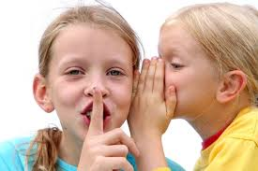
Tell me your secrets
Sometimes we are asking families to share a lot of information with us, where there is little or no relationship. Building a relationship is vital to avoid resistance.

Slide 11
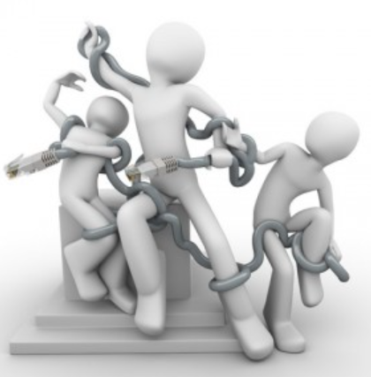
3 types of Resistance
DISGUISED COMPLIANCE
HOSTILITY
NON-ENGAGEMENT

Slide 12
Possible reasons for resistance
Self Esteem
People embarrassed at needing help from professional agencies, fear of being labelled a bad parent, addict, abuser etc.
Lack of trust
Often from previous poor experiences of social work agencies/ worker
Disagreements about the cause of the problems and difficulties in effectively communicating this
Fear of the power of professionals to intervene in their life give little information and therefore can’t be used against them

Slide 13
What disguised compliance looks like
No significant change at reviews despite significant input
Parents/carers agreeing with professionals regarding required changes but put little effort into making changes work
Change does occur but as a result of external agencies or external resources not the parental/carers efforts
Change in one area of functioning is not matched by change in other areas
Parents/carers will engage with certain aspects of a plan only
Parents/carers align themselves with certain professionals
Child’s report of matters conflict with parent/carers report

Slide 14
Disguised Compliance – What do I need to consider in my practice?
Am I easily taken in by what people tell me?
Do I easily accept at face value and not be curious?
Am I easily intimidated?
Do I seek a compromise?
Am I easily persuaded by parents who appear particularly willing or co-operative?
Am I able to bring challenge to families?
Do I challenge my own thinking?
Do I keep the focus on the child and impact of the current situation on their wellbeing and future life chances?
Parental Participation is NOT the same as Parental Cooperation

Slide 15

Asking the right questions
Rehearse any questions in advance, of areas you wish to explore
Every question you ask should help you gather either facts or opinions. Know what kind of information you need and frame your questions accordingly.
Actively listen to the response
Aim transition to the next question naturally
Notes:
October 2018

Slide 16
Asking the right questions continued..
Example
Are health appointments up to date?
If not, why not? Who is the health visitor?
Families need to be aware that professionals communicate, and you will find out information from others.
If families are not engaging, ask them directly why this is and what can you do to help them engage better.
Always let them know that you are there to help and resolve any difficulties.
Research into practice
Notes:
October 2018

Slide 17
Dealing with Hostile or uncooperative parents
  This includes the following:-
  Physical violence
  Verbal and emotional aggression
  Threatening and intimidating language and or body posture
  Persistent intimidating action such as repeated complaints about the worker.

Slide 18

Dealing with hostility
Keep yourself safe, let someone know where you are going
Go prepared
Remain calm
Be yourself
Remain focused and keep the child at the centre, focusing on the child’s best interest.
Be open and honest with the family
Ask them, how do they see the situation

Slide 19
Impact of parental behaviours on professionals
The impact of these behaviors on professionals will vary but can greatly affect their ability to accurately assess risk, make good decisions and judgments, interpret other family information, and make meaningful interventions.​
Northumberland County Council 2019

Slide 20
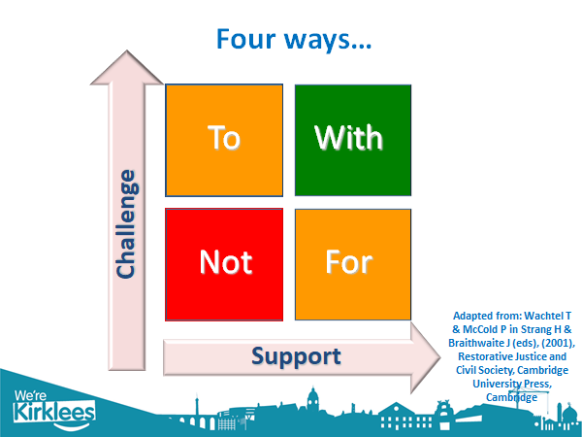
Restorative Approach
In Kirklees we are aiming to develop a restorative approach to all that we do, so that we work with people rather than doing things to them or for them.

Slide 21
Restorative practice
Scenario
Joe is aged 3 with Cerbal Palsy and has been missing key health appointments. As a professional working with the family you are worried about the impact this will have on meeting his health needs.
Notes:
Give some examples of what doing to would look like or doing with etc…
What is the impact of the different approaches
What is the long and short term impact on the child
October 2018

Slide 22
Working WITH the family
Suggested questions to ask:_
How do you know when your appointments are?
Where do you record the upcoming appointments?
What would help you to remember these?
Where are you going for these appointments?
How are you going to get to the appointments?
This would support highlighting any barriers to attending.

Slide 23
Daily Lived Experience of the Child
What a child sees, hears, thinks and experiences daily that impacts on their personal development and welfare whether that be physically or emotionally. As practitioners we need to; actively hear what the child has to say or communicate,…
What is a day like in a child`s life from the moment they wake up to the evening when they go to bed?
Notes:
Tables to think of questions that they can ask to draw out what is happening in the different sections of the day
October 2018

Slide 24
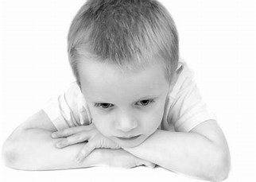
Consider each child’s day
Ask the child for their views
At school:
How do you get to school?
Who goes with you to school?
What do you do at playtime?
Who collects you from school?
Getting up:
What time do you get up?
What do you have for breakfast?
Who gets you ready for school?
Bedtime
Do you have a bedtime?
What do you do at bedtime?
Who takes you to bed?
Where do you sleep?
After school/evening:
What do you do after school?
Do you see any of your friends?
What do you play with?
What do you eat?

Slide 25
Possible examples morning
If a child hasn’t eaten;
They may wake up hungry and may have slept badly
May be thinking about when or where their next meal will come from
May lack energy to get dressed or play
At home/school they may not be able to concentrate or learn and be distracted

Slide 26
Possible example evening
May be lethargic with lack of energy
May be unable to follow basic instructions and unable to think clearly
Child may not have an evening meal and the cycle begins again.
Consider what may be the impacts on a child living in a household where there may be:-
Chaotic parenting
Domestic /Sexual Abuse
substance misuse
Mental health issues

Slide 27
Consider what topic you might struggle to discuss?
Mental Health
Faith
Finances
Parenting issues
Domestic Abuse
Sex
Hygiene
Culture
Disability

Slide 28
Test yourself
Name three things what Serious Case Reviews and Ofsted 2019 tell us we are not doing well.
Name three different ways in which we communicate.
Name two types of resistance we may get from families.
What is meant by Restorative Practice in Kirklees?
Name four topics people may struggle to discuss with families.

Slide 29
Answers
No clear outcomes, poor analysis, lack of focus on child’s experience, assumptions, fear of challenge, poor recording
Body language, written communication, speaking and listening
Hostility, disguised compliance, none engagement
Work with people rather than doing things to them or for them.
Sex, faith, finances, mental health, disability, domestic abuse, parenting issues

Slide 30
Suggested further reading
Working Together 2018
Child Act 1989
Kirklees Safeguarding Children Partnership
Information Sharing Dept of Education (DfE)
https://www.northumberland.gov.uk/NorthumberlandCountyCouncil/media/Child-Families/Safeguarding/Working-with-hostile-and-uncooperative-parents.pdf
https://www.leedsscp.org.uk/LSCB/media/Images/pdfs/Day-in-the-Life-of-a-Child-Child-s-Views.pdf
Explore by yourself
Karpman Drama Triangle
Restorative Practice
Resistance in families

Slide 31
Key additional courses
Working together to safeguard children
Assessment and analysis skills
Protection conferences and core groups

Slide 32
Thank you

